Slide 1
The Pediatric Chain of Survival
Dariush Abtahi, MD
Assistant Professor of Anesthesiology, Clinical Research and Development Unit Imam Hossein Hospital, Anesthesiology Department, Shahid Beheshti University of Medical Sciences, Tehran, Iran
drdariushabtahi@yahoo.com

Slide 2
“A chain is no stronger than its weakest link.”
–Thomas Reid, 1785

Slide 3
> 20,000/y cardiac arrest in infants and children
>7000 OHCA, 2015
>12 IHCA/1000 hospital admissions

Slide 4
Neurological outcomes remain difficult to assess across the pediatric age spectrum
Favorable neurological outcome: 47% of survivors to discharge

Slide 5
education
(lay public, resuscitation providers)
Chain of Survival
guidelines
essential components for good resuscitation outcomes

Slide 6
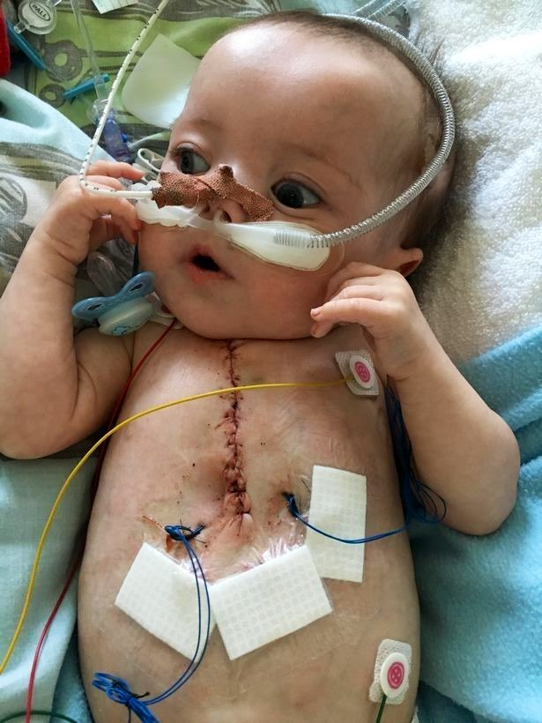
Pediatric cardiac arrest ≠ adult / neonatal cardiac arrest
epidemiology
pathophysiology
etiologies
result of progressive respiratory failure/shock
variable period of deterioration
In children with congenital heart disease, cardiac arrest is often due to a primary cardiac cause, although the etiology is distinct from adults.

Slide 7
Survival rates from OHCA remain not encouraging.
Survival to hospital discharge between 2007 and 2012 ranged from 6.7% to 10.2%.
Improved outcomes for pediatric IHCA over the past 20 years
early recognition
high-quality CPR
postarrest care
extracorporeal cardiopulmonary resuscitation (ECPR)
More cardiac arrest events now occur in an ICU setting, suggesting that patients at risk for cardiac arrest:
identified sooner
transferred to a higher level of care

Slide 8
As survival rates from pediatric cardiac arrest increase, more focus on:
physical outcomes
emotional outcomes
neurodevelopmental outcomes
25% of patients with favorable outcomes have global cognitive impairment
85% of older children who were reported to have favorable outcomes have selective neuropsychological deficits.

Slide 9
Historically, cardiac arrest care has largely focused on the management of the cardiac arrest itself.
However, there are aspects of pre-arrest and post-arrest care that are critical to improving outcomes:
OHCA
safety initiatives (eg, bike helmet laws)
sudden infant death syndrome prevention
lay rescuer CPR training
early access to emergency care
IHCA
Early recognition and treatment of patients at risk:
neonates undergoing cardiac surgical procedures
acute fulminant myocarditis
acute decompensated heart failure
pulmonary hypertension

Slide 10
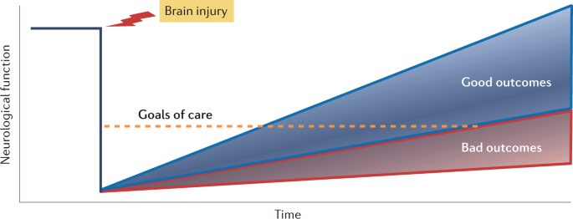
Management of the post-cardiac arrest syndrome:
brain dysfunction
myocardial dysfunction with low cardiac output
ischemia or reperfusion injury
Accurate neuroprognostication to guide caregiver discussions and decision-making.
Early referral for rehabilitation assessment and intervention

Slide 11
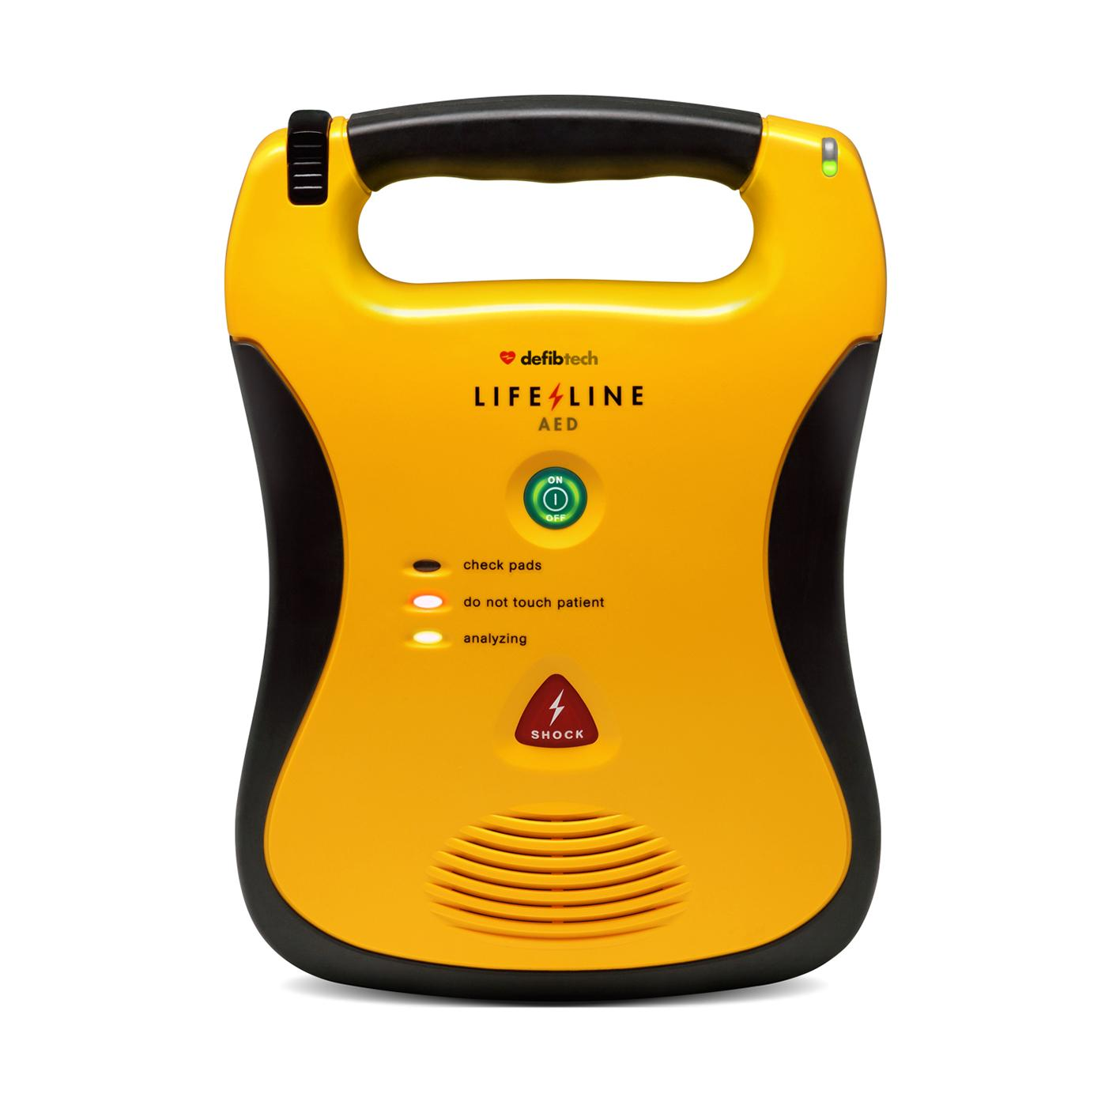
If help is nearby or a cell phone is available, activating the emergency response and starting CPR can be nearly simultaneous.
In an out-of-hospital setting + single rescuer + no access to cell phone = begin CPR for infants/children before calling for help
respiratory arrest is the most common cause
help may not be nearby
In the event of a sudden witnessed collapse, rescuers should use an available automatic external defibrillator (AED).

